Slide 1
E Z Rpart
George Ding

Slide 2
With the addition of rpart…
We are allowed to use extensive use of Rstudio’s libraries to get a 90% and up on a generated formula based tree!
But before we start…
Lets take a look at the tree structure, before actually analyzing the actual prediction.

Slide 3
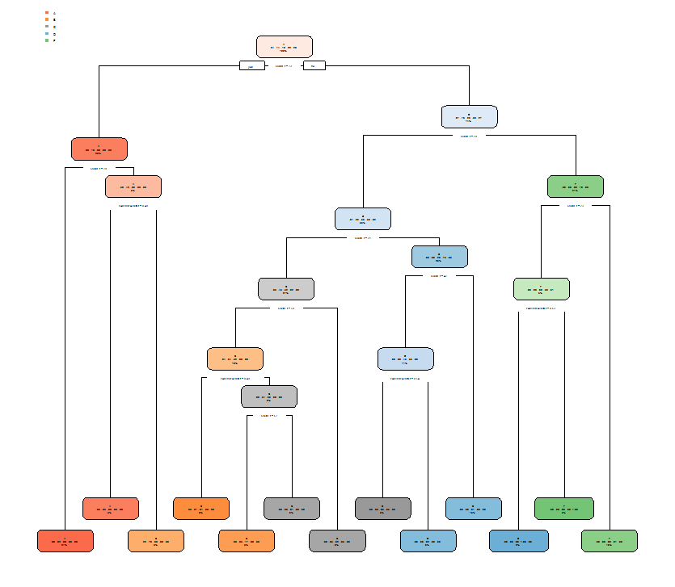
Our first tree:
Code:
>tree <- rpart(GRADE ~ SCORE+ASKS_QUESTIONS+LEAVES_EARLY+PARTICIPATION,data=M2017_train)
>rpart.plot(tree)
A simple tree, with all exceptional outliers, this is a bit hard to read for the size it has been created.

Slide 4
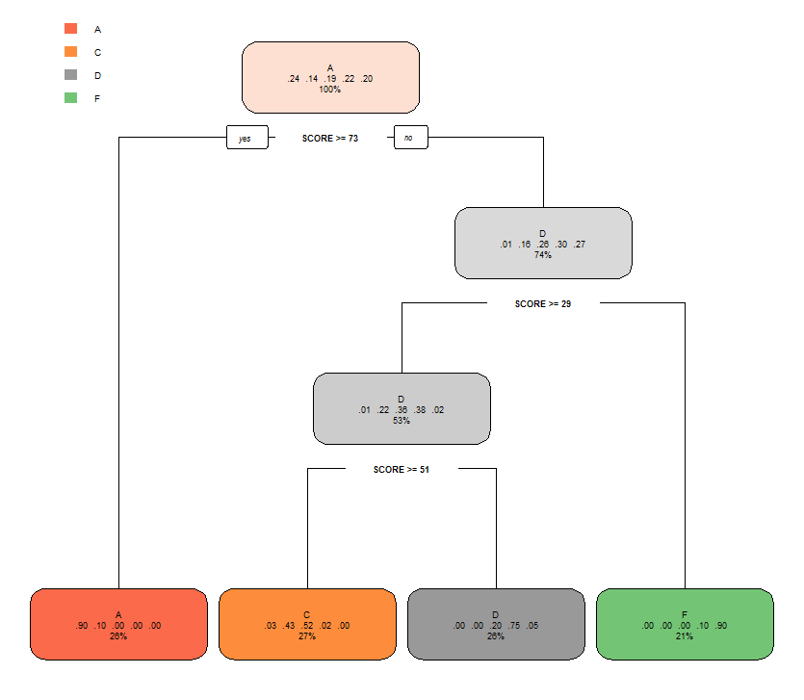
Lets add some changes: (Minisplit)
Code:
>tree <- rpart(GRADE ~ SCORE+ASKS_QUESTIONS+LEAVES_EARLY+PARTICIPATION,data=M2017_train,control=rpart.control(minsplit = 300))
>rpart.plot(tree)
Analysis:
With the help of Rstudio, we can see how the computer breaks down each individual node. It starts with a mean grade for the head node, or the A, and establishes that people that people with scores of >= 73 generally all have A’s. The outliers gets broken down into a farther down node, where it analyzes the other attributes the student may have to improve their grade. It does the same to the rest and moves down to a D node, where the second majority of students have achieved.

Slide 5
Another method: (MiniBucket)
Code:
>tree <- rpart(GRADE ~ SCORE+ASKS_QUESTIONS+LEAVES_EARLY+PARTICIPATION,data=M2017_train,control=rpart.control(minbucket =100))
>rpart.plot(tree)
Analysis:
Same work done by the computer, but by implementing the minimum number of observations in any terminal node for a split in a node to be done.

Slide 6
However,
These codes only help with visual trees, not for actual prediction coding!
Code:
(Using previous, minibucket decision code line)
>decision <- predict(tree, newdata = M2017_train,type = 'class')
>test <- M2017_train$GRADE > error <- mean(decision != test)
> error
[1] 0.2395709

Slide 7
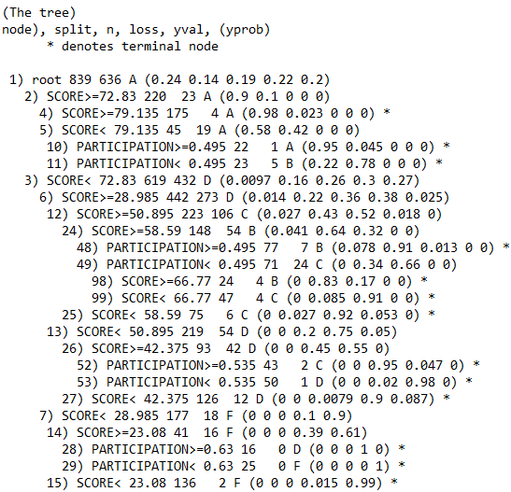
Therefore, lets run an actual prediction:
Code:
> install.packages("rpart")
> install.packages("rpart.plot")
> library(rpart)
> library(rpart.plot)
> tree <- rpart(GRADE ~ SCORE+ASKS_QUESTIONS+LEAVES_EARLY+PARTICIPATION, data = M2017_train)
(Tree’s rpart.plot without the plot)
->

Slide 8
Rcode cont:
Code:
> decision <- predict(tree, newdata = M2017_train,type = 'class')
> test <- M2017_train$GRADE
> error <- mean(decision != test)
> error
[1] 0.05721097
Hey, our accuracy is pretty spot on, but what if the attributes, (one or another is simply a dud?)

Slide 9
This doesn’t take much editing:
Code:
> tree <- rpart(GRADE ~ SCORE+ASKS_QUESTIONS+PARTICIPATION, data = M2017_train)
> decision <- predict(tree, newdata = M2017_train,type = 'class')
> error <- mean(decision != test)
> error
[1] 0.05721097
> tree <- rpart(GRADE ~ SCORE+PARTICIPATION, data = M2017_train)
> decision <- predict(tree, newdata = M2017_train,type = 'class')
> error <- mean(decision != test)
> error
[1] 0.05721097
> tree <- rpart(GRADE ~ SCORE, data = M2017_train)
> decision <- predict(tree, newdata = M2017_train,type = 'class')
> error <- mean(decision != test)
> error
[1] 0.1847437

Slide 10
Conclusion?
Judging these outcomes, it seems as if only participation had any real effect on the score itself.
The end.

